Slide 1
INFO 250 Information Visualization
Week 3B: Applying the Task by Data Type Taxonomy

Slide 2
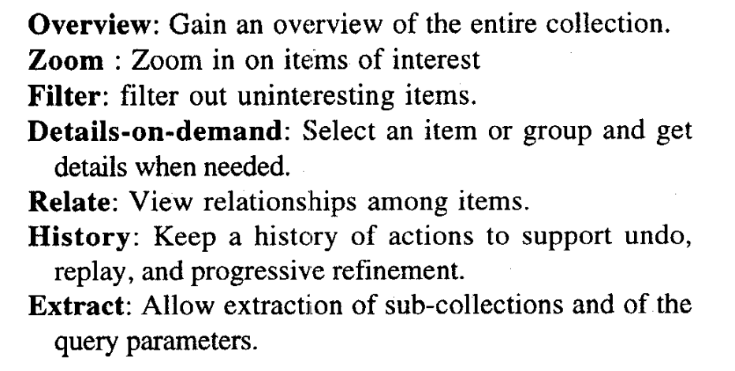
Task by Data Type Taxonomy

Slide 3
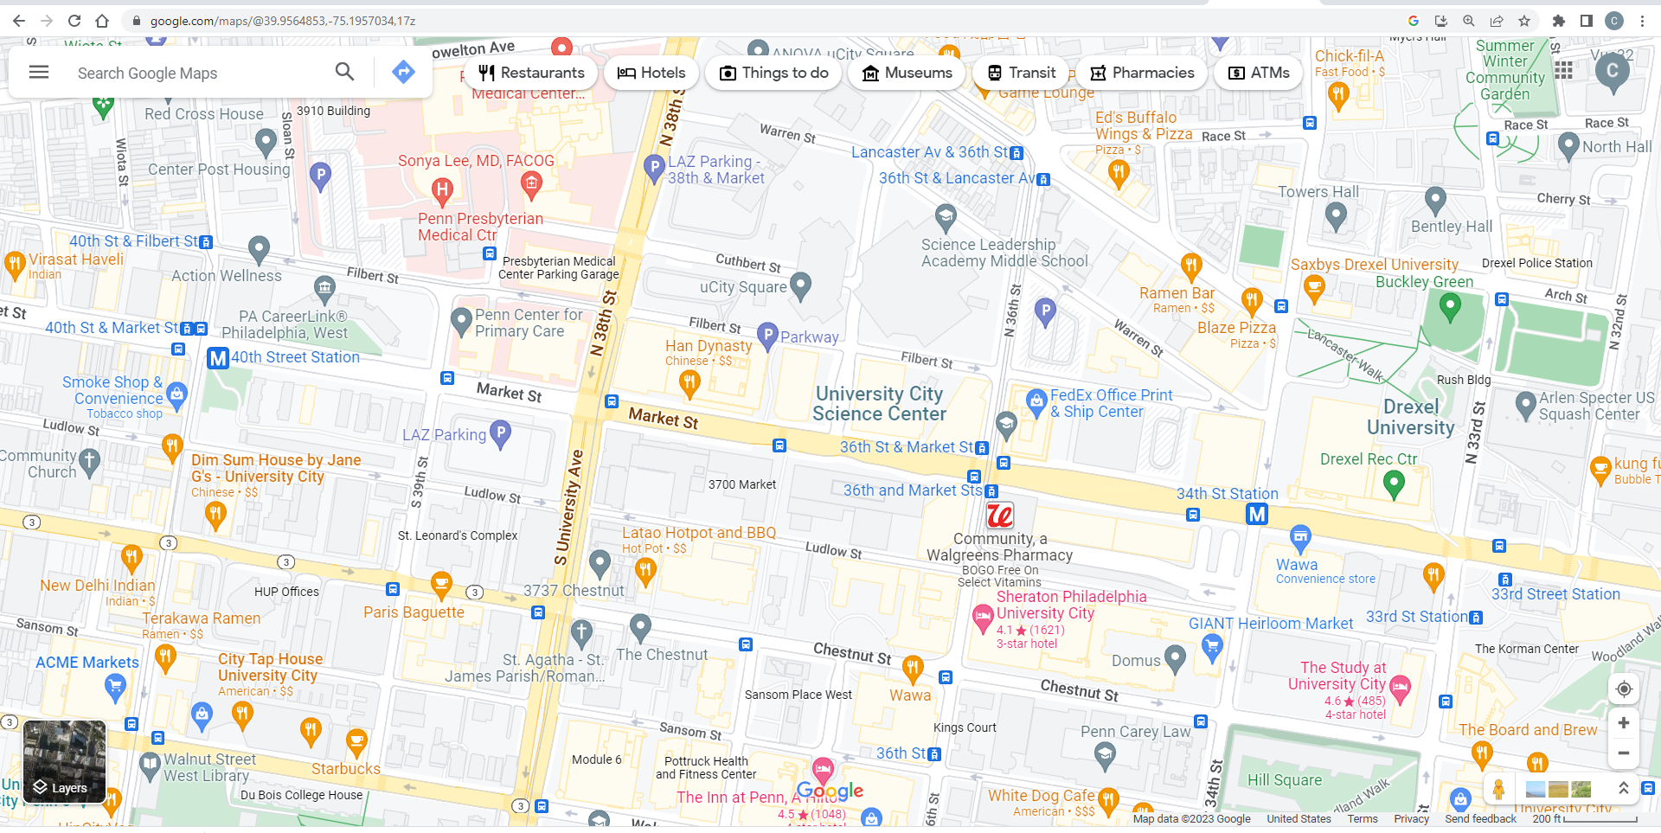
Example I: Google Maps
https://www.google.com/maps/
Overview
Zoom
Filter
Details-on-demand
Relate
History
Extract

Slide 4
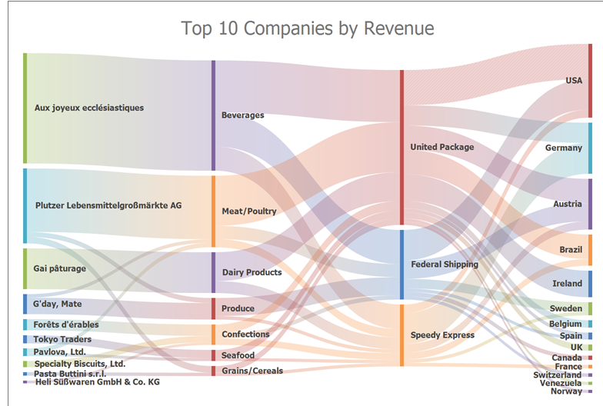
Example II: Sankey
https://docs.devexpress.com/WindowsForms/402543/controls-and-libraries/sankey-diagram-control
Overview
Zoom
Filter
Details-on-demand
Relate
History
Extract

Slide 5
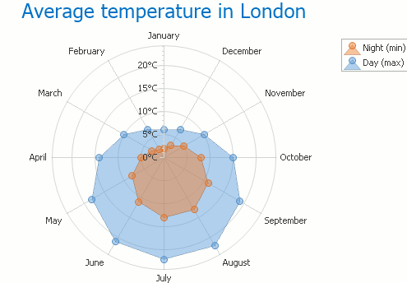
Example III: Radar Area Chart https://docs.devexpress.com/WindowsForms/3314/controls-and-libraries/chart-control/series-views/2d-series-views/radar-series-views/radar-area-chart
Overview
Zoom
Filter
Details-on-demand
Relate
History
Extract

Slide 6
User tasks in information visualization
The user task (interactivity) is a function of:
Dynamicity
Complexity
Nature of questions
Type of information system
Visualization tool
Interactive graphs can be very different from static graphs, but they largely follow the same designing principles.

